Slide 1
Software Testing
Test Automation* (Jenkins)
Presented By
Ning Chen, Ph.D.
Professor
Department of Computer
Science
California State University,
Fullerton
© Ning Chen, 2017
*
*Based on Jenkins

Slide 2
Module Objectives
This module focuses on understanding continuous integration (CI)

Slide 3
Jenkins
https://jenkins.io/
Jenkins is an open source automation server written in Java.
Jenkins helps to automate the non-human part of the whole software development process with now common things like continuous integration (CI) and by empowering teams to implement the technical aspects of continuous delivery.

Slide 4
Scenario
You are a test automation engineer.
  Our client is currently seeking a Automation Engineer!
  **W-2 Candidates Only**Selenium and Jenkins experience REQUIRED**
  This job will have the following responsibilities:
  Contribute to an existing test automation system by identifying opportunities for automating manual test cases, implement new test cases to increase test coverage, and maintain existing automated tests as needed.
  Review daily automated test results to find bugs, defects, and regressions. In addition to writing automated tests, the candidate will contribute to the development and maintenance of the end to end CI/CD process.
  Demonstrate contributions made on bi-weekly basis as part of end of sprint cycle.
  Qualifications & Requirements:
  7 years of QA experience, 2 of those years MUST include writing software test scripts to perform testing UI automation.
  Experience with Java, JavaScript, or Python
  Strong automated quality assurance testing background
  Experience writing, debugging and executing test scripts
  Experience with Appium, Selenium, XCTest
  Use of integration tools for automation testing
  Have used, applied or have strong knowledge of one or more of the following: - JSON - Jenkins - REST - XML - Data mining / Data parsers (have written or modified) - TestNG or JUnit - GIT
  Strong communication and initiative
  A great flexible attitude

Slide 5
Scenario
Your job is to help your developer colleagues build and test their works.
Let’s say you have five developer colleagues and today they have finished 5 unit modules and uploaded to the master branch of the version control system (say, Github).
The automation system you built needs to build the master branch at midnight.

Slide 6
Installation
https://www.howtoforge.com/tutorial/how-to-install-jenkins-with-apache-on-ubuntu-16-04/

Slide 7
How to Run
sudo systemctl restart apache2
sudo systemctl restart jenkins
http://192.168.1.243:8080/ (my local machine; yours will be different)

Slide 8
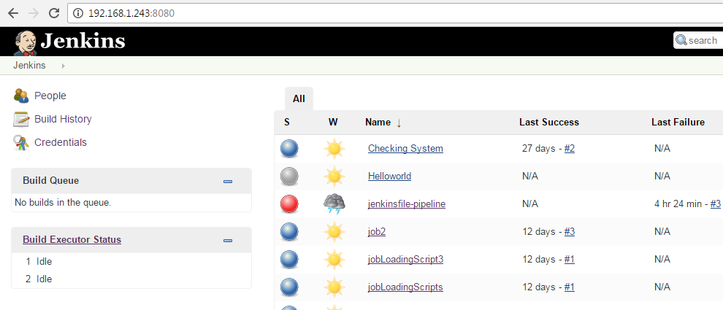
First Page Seen by Browser

Slide 9
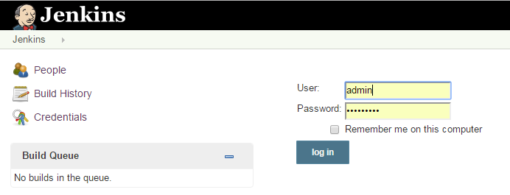
Need to Log In as Admin

Slide 10
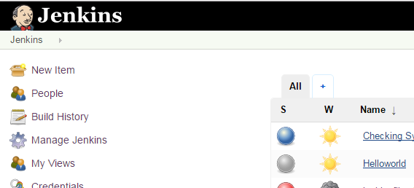
Create a New Item

Slide 11
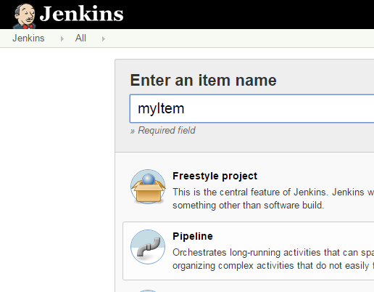
Select Pipeline

Slide 12
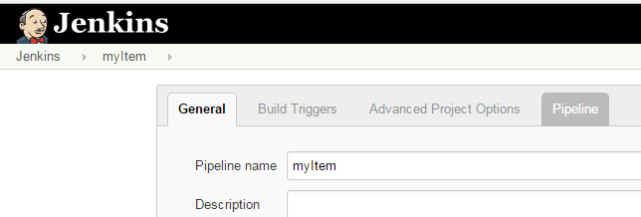
Pipeline Tab

Slide 13
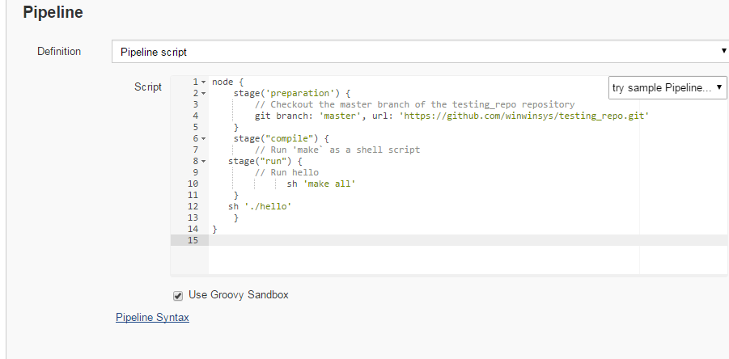
Pipeline node

Slide 14
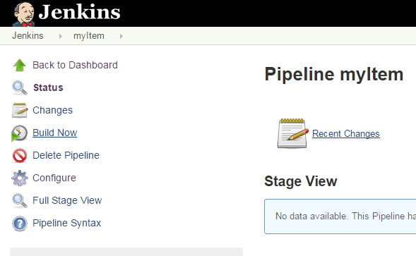
Build Now

Slide 15
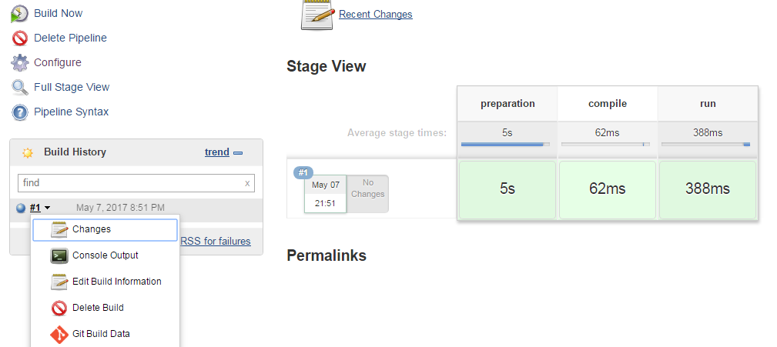
Results

Slide 16
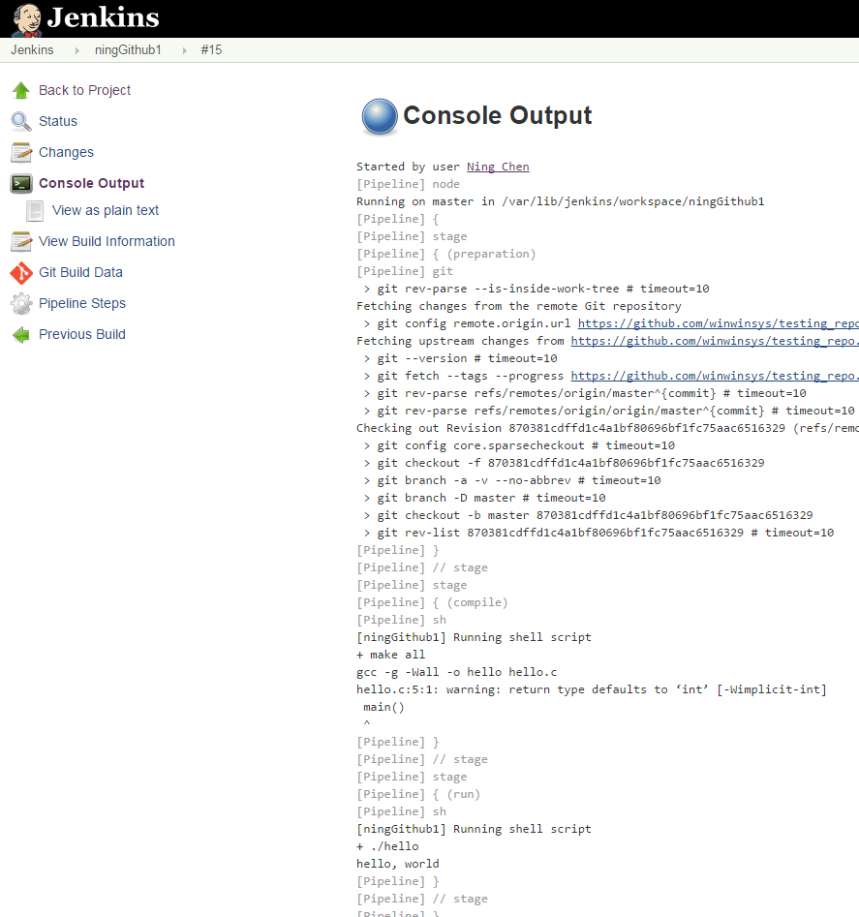
Console Output

Slide 17
Pipeline File Location
In the previous example, the pipeline file (i.e., Jenkins instructions that tell Jenkins what to do things) is within the “item” of Jenkins.
It is important to note that the “branch” (i.e., source code of the project) is NOT in Jenkins. It is stored in a version control server (in the previous example, in a public git server, the github.com).

Slide 18
Pipeline File Location
In most cases it is very convenient (or at least, it is easier to organize things) if we store the “pipeline file” with the source code (this means to the source code also on the version control server).
Logically it makes sense. The “pipeline file” tells Jenkins how (and what) to do with the project source code. The best place to “safe keep” that “pipeline file” should be the location that stores the source code.

Slide 19
Pipeline File (Jenkinsfile)
Jekins supports the saving of the “pipeline file” (in this case called “Jenkinsfile” on the version control server.

Slide 20
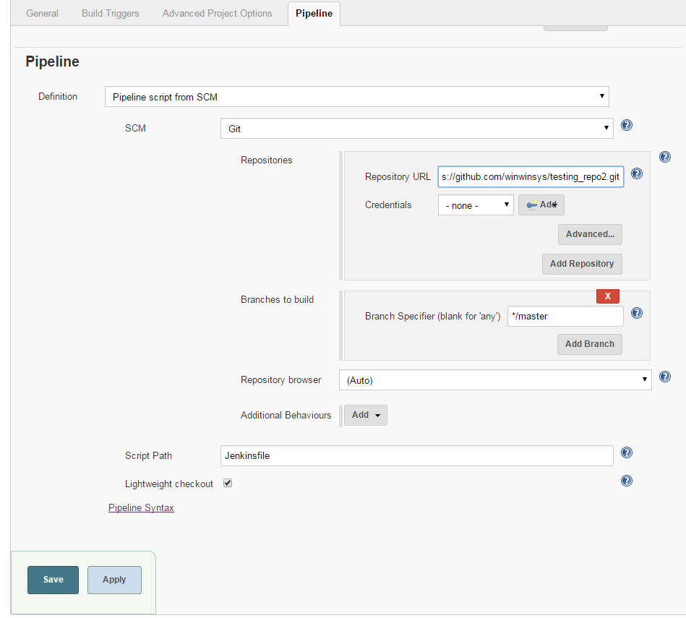
Pipeline File (Jenkinsfile)

Slide 21
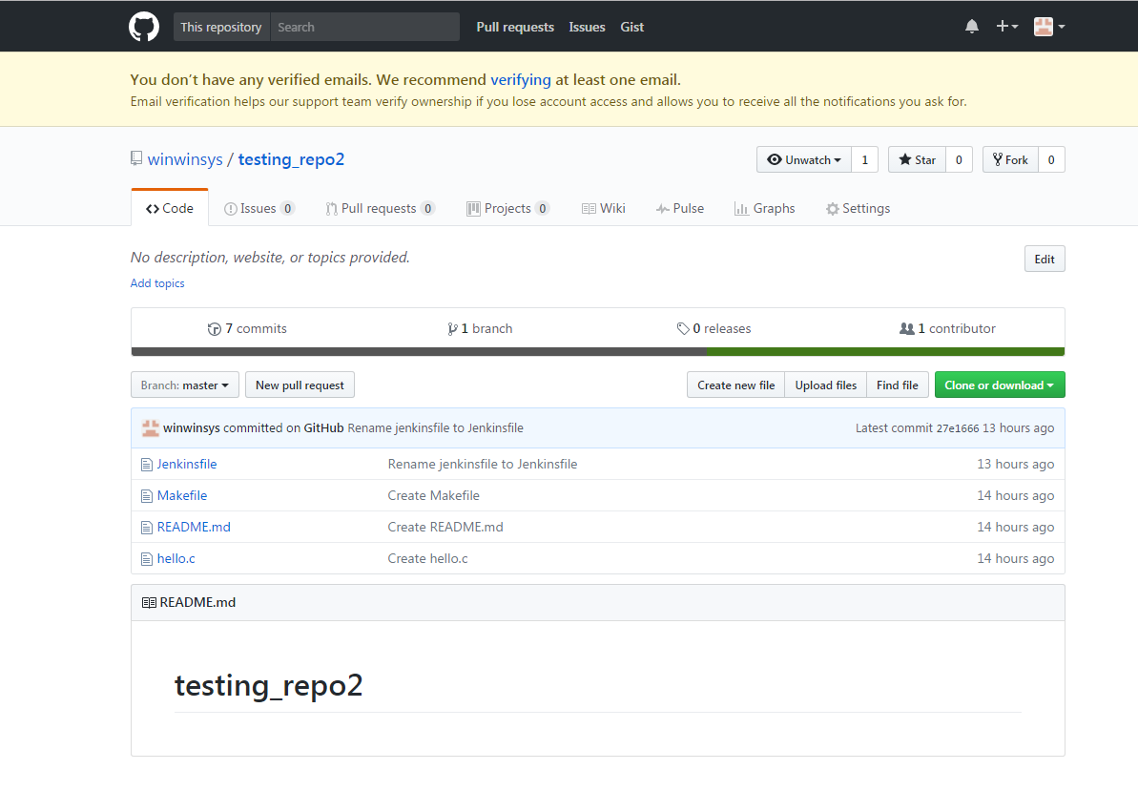
Version Control Server (Github.com)

Slide 22
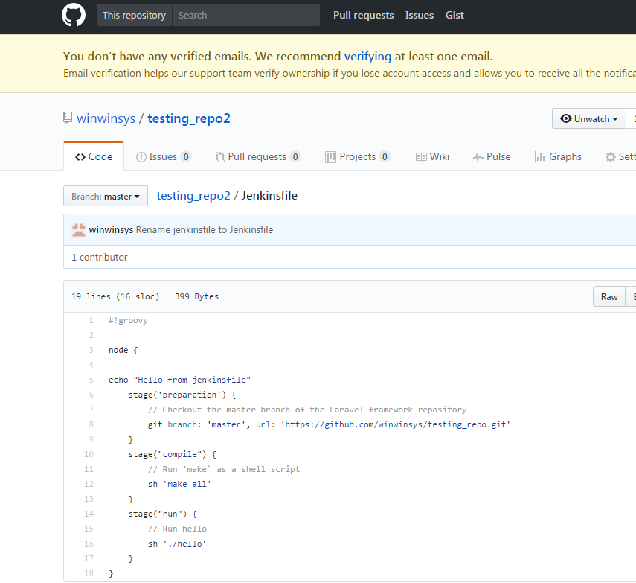
Jenkinsfile

Slide 23
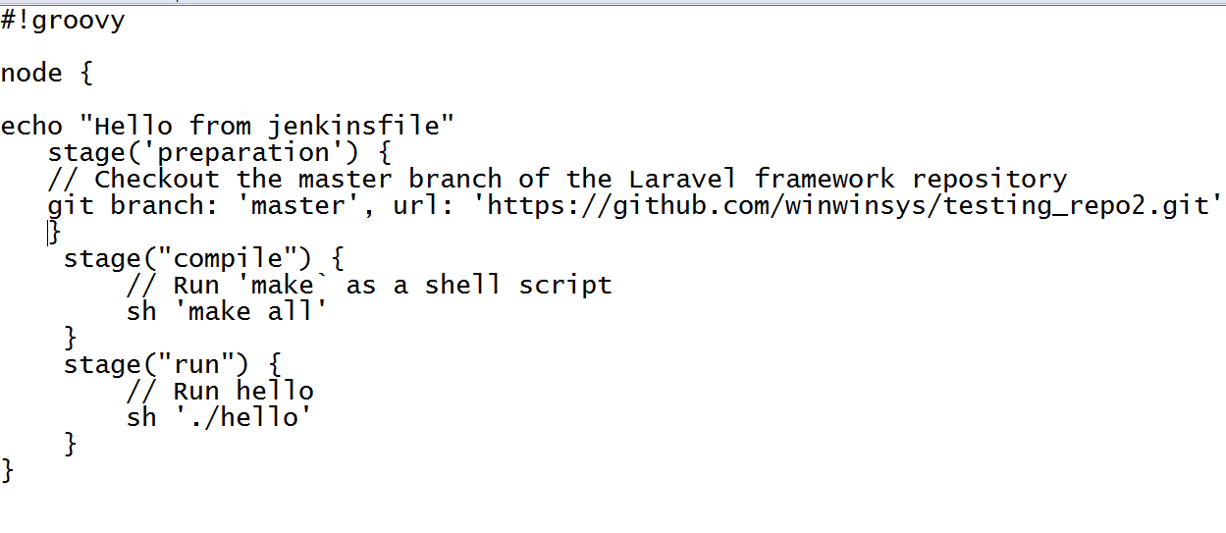
Jenkinsfile

Slide 24
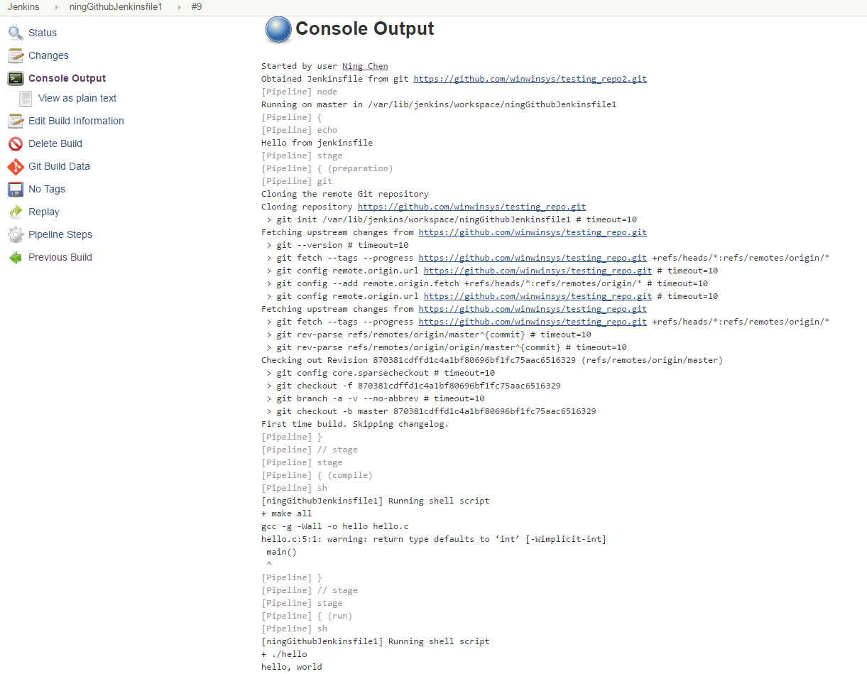
Build and Console Output

